Slide 1
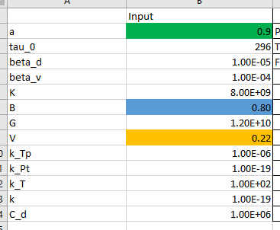

Slide 2
Temperature induced pore pressure

Slide 3
Temperature induced pore pressure rate

Slide 4
Pore pressure induced pore pressure

Slide 5
Pore pressure induced pore pressure rate

Slide 6
Total effective stress

Slide 7
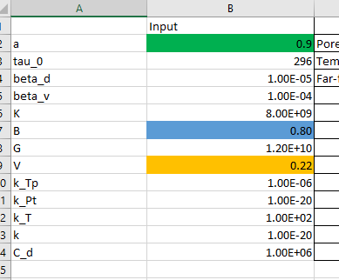

Slide 8
Temperature induce temperature change

Slide 9
Temperature induce temperature change_rate

Slide 10
Pore pressure induced pore pressure

Slide 11
Pore pressure induced pore pressure_rate

Slide 12
Pore pressure induced pore pressure

Slide 13
Temperature induced pore pressure

Slide 14
Temperature induced pore pressure_rate

Slide 15
Temperature induced pore pressure_rate

Slide 16
Far field induced pore pressure

Slide 17
Far field induced pore pressure

Slide 18
Far field induced pore pressure

Slide 19
Total effective stress

Slide 20
Figure. 5

Slide 21
Figure. 7

Slide 22
Transition Zone
Damage Zone
Safe Zone
Zeta Two: MND
Zeta One: HTND

Slide 23
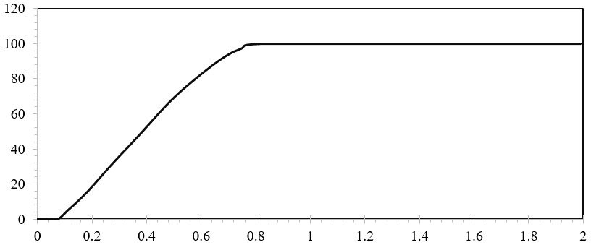
Probability of Generating Tensile Case(%)

